Slide 1
Sample Questions for Review Towards the Final Exam
Notes:
Version History
8.0 (May 2020)
All slides reformatted for 16:9 aspect ratio
All slides updated to 8th edition material
Use of Calibri font, rather that Gill Sans MT
Add LOTS more animation throughout
added new 8th edition material on middleboxes (and Internet arch), Net neutrality, buffering …
lighter header font
8.2 (July 2023), changes from 8.0:
some minor updates (e.g., IPv6 stats updated) but not much has changed.

Slide 2

Chapter 1 Introduction
Computer Networking: A Top-Down Approach 8th edition Jim Kurose, Keith Ross Pearson, 2020
Acknowledgement: Based on the textbook’s website: https://gaia.cs.umass.edu/kurose_ross/index.php
Notes:
(8.2)Version
7.2 (January 2020)
All slides reformatted for 16:9 aspect ratio
Use of Calibri font, rather that Gill Sans MT
Updated slide content for 2020 link technologies and applications
Add more animation throughout
New Master slide
Feb. 2020 (8.0)
a few updates suggest by Catherine Rosenberg (thanks!)
titles in a lighter font
Sept 2020 (8.1)
Added ~7 new slides, in particular: data center slide; routing versus forwarding; security line of defense; several on encapsulation and layers (this section is a lot better now). Other relative minor changes throughout
Feb. 2023 (8.2)
few minor updates (mostly speeds, technology details)

Slide 3

Packet delay: four sources
IMPORTANT
transmission
A
propagation
B
nodal
processing
queueing
d_{nodal} = d_{proc} + d_{queue} + d_{trans} + d_{prop}
d_{trans}: transmission delay:
L: packet length (bits)
R: link transmission rate (bps)
d_{trans} = L/R
d_{prop}: propagation delay:
d: length of physical link
s: propagation speed (~2x10⁸ m/sec)
d_{prop} = d/s
d_{trans} and d_{prop}
very different

Slide 4
Throughput
IMPORTANT
throughput: rate (bits/time unit) at which bits are being sent from sender to receiver
instantaneous: rate at given point in time
average: rate over longer period of time
link capacity
R_{s} bits/sec
link capacity
R_{c} bits/sec
pipe that can carry
fluid at rate
(R_{s} bits/sec)
pipe that can carry
fluid at rate
(R_{c} bits/sec)
server sends bits
(fluid) into pipe
server, with
file of F bits
to send to client

Slide 5
Throughput
IMPORTANT
R_{s} < R_{c} What is average end-end throughput?
R_{s} bits/sec
R_{c} bits/sec
R_{s} > R_{c} What is average end-end throughput?
R_{s} bits/sec
R_{c} bits/sec
bottleneck link
link on end-end path that constrains end-end throughput

Slide 6
Throughput: network scenario
IMPORTANT
per-connection end-end throughput: min(R_{c},R_{s},R/10)
in practice: R_{c} or R_{s} is often bottleneck
Link utilization: used bandwidth/available bandwidth. For the three links:
min(R_{c},R_{s},R/10)/R_{s}
min(R_{c},R_{s},R/10)/(R/10)
min(R_{c},R_{s},R/10)/R_{c}
R_{s}
R_{s}
R_{s}
R
R_{c}
R_{c}
R_{c}
10 connections (fairly) share backbone bottleneck link R bits/sec
* Check out the online interactive exercises for more examples: http://gaia.cs.umass.edu/kurose_ross/

Slide 7
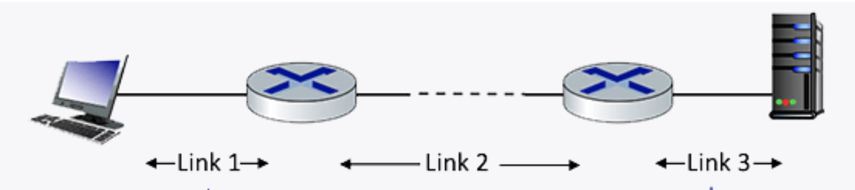
Question 1.4-01a
1.4-01a. Performance: Delay. Consider the network shown in the figure below, with three links, each with a transmission rate of 1 Mbps, and a propagation delay of 1 msec per link. Assume the length of a packet is 1000 bits.
What is the end-end delay of a packet from when it first begins transmission on link 1, until is it received in full by the server at the end of link 3. You can assume that queueing delays and packet processing delays are zero, but make sure you include packet transmission time delay on all links. Assume store-and forward packet transmission.
Each link has transmission delay 1000 bits/1 Mbps = 1ms. So each link has total delay of transmission + propagation = 1+1=2 ms.
For the three links, the total delay = 2 + 2 + 2 = 6 ms. `

Slide 8
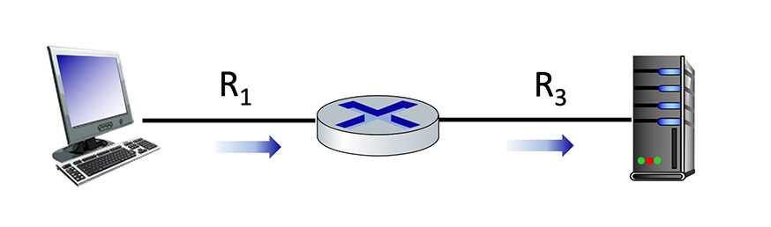
Question 1.4-01b
Maximum end-end throughput. Consider the scenario shown below, with a single source client sending to a server over two links of capacities R1=100 Mbps and R3=10 Mbps.
What is the maximum achievable end-end throughput (in Mbps, give an integer value) for the client-to-server pair, assuming that the client is trying to send at its maximum rate?
min (R1, R3) = min (100, 10) = 10 Mpbs.

Slide 9
Question 1.4-01c
Performance: Maximum end-end throughput. Consider the scenario shown below, with a single source client sending to a server over two links of capacities R1=10 Mbps and R3=100 Mbps.
What is the maximum achievable end-end throughput (in Mbps, give an integer value) for the client-to-server pair, assuming that the client is trying to send at its maximum rate?
min (R1, R3) = min (10, 100) = 10 Mpbs.

Slide 10
Question 1.4-01c
Performance: Maximum end-end throughput. Consider the scenario shown below, with a single source client sending to a server over two links of capacities R1=10 Mbps and R3=100 Mbps.
What is the maximum achievable end-end throughput (in Mbps, give an integer value) for the client-to-server pair, assuming that the client is trying to send at its maximum rate?
min (R1, R3) = min (10, 100) = 10 Mpbs.

Slide 11
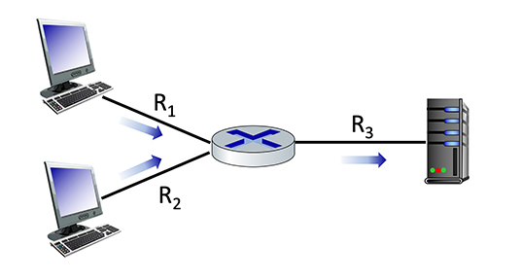
Question 1.4-01d
100 Mbps
10 Mbps
1.4-01e. Performance: Maximum end-end throughput. Consider the scenario shown below, with two clients sending to a server. The links attached to clients each have a capacity of R1= R2 = 100 Mbps. The link from the router to the server has a capacity of and R3 = 10 Mbps, which is shared evenly between the two sources when they are each sending at their maximum rate.
What is the maximum achievable end-end throughput (in Mbps, give an integer value) for each client-to-server pair, assuming that the client is trying to send at its maximum rate?
100 Mbps
The maximum achievable end-end throughput is min (R1, R3/2) = min (R2, R3/2) = min (100, 10/2) = 5 Mbps.
The shared 100 Mbps link is fairly shared among two end-to-end connections (R1, R3) and (R2, R3), hence each end-to-end connection gets 10/2=5 Mbps.
Notes:
The link bandwidth is independent of the transmission direction.

Slide 12
Question 1.4-01e
10 Mbps
100 Mbps
1.4-01e. Performance: Maximum end-end throughput. Consider the scenario shown below, with two clients sending to a server. The links attached to clients each have a capacity of R1= R2 = 10 Mbps. The link from the router to the server has a capacity of and R3 = 100 Mbps, which is shared evenly between the two sources when they are each sending at their maximum rate.
What is the maximum achievable end-end throughput (in Mbps, give an integer value) for each client-to-server pair, assuming that the client is trying to send at its maximum rate?
10 Mbps
The maximum achievable end-end throughput is min (R1, R3/2) = min (R2, R3/2) = min (10, 100/2) = 10 Mbps.
The shared 100 Mbps link is fairly shared among two end-to-end connections (R1, R3) and (R2, R3), hence each end-to-end connection gets 100/2=50 Mbps.
Note that min (R1, R2, R3/2) is incorrect, since R1 and R2 are on deferent end-to-end connections.
Remember that parallel links should never be put into the min() formula, only sequential links forming the same end-to-end connection should be in the same min() formula.
Notes:
The link bandwidth is independent of the transmission direction.

Slide 13
Question 1.4-01e variations
10 Mbps
100 Mbps
1.4-01e. Performance: Maximum end-end throughput. Consider the scenario shown below, with two clients sending to a server. The links attached to clients each have a capacity of R1 = 10 Mbps, R2 = 20 Mbps. The link from the router to the server has a capacity of and R3 = 100 Mbps, which is shared evenly between the two sources when they are each sending at their maximum rate.
What is the maximum achievable end-end throughput (in Mbps, give an integer value) for each client-to-server pair, assuming that the client is trying to send at its maximum rate?
20 Mbps
For client on top, the maximum achievable end-end throughput is min (R1, R3/2) = min (10, 100/2) = 10 Mbps.
For client on bottom, the maximum achievable end-end throughput is min (R1, R3/2) = min (20, 100/2) = 20 Mbps.
The shared 100 Mbps link is fairly shared among two end-to-end connections (R1, R3) and (R2, R3), hence each end-to-end connection gets 100/2=50 Mbps.
Notes:
The link bandwidth is independent of the transmission direction.

Slide 14
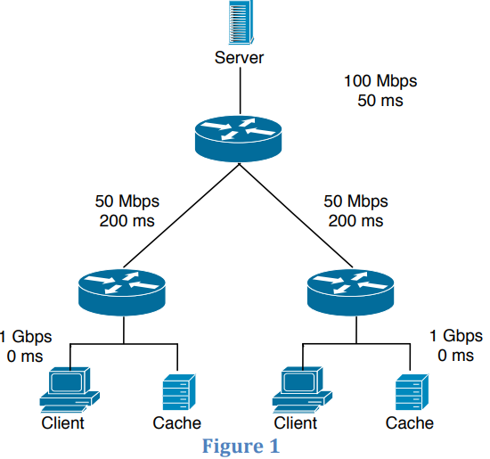
Question 1.4-02a
Consider the scenario shown in Figure 1 in which a server is connected to a router by a 100Mbps link with a 50ms propagation delay. Initially this router is also connected to two routers, each over a 50Mbps link with a 200ms propagation delay. A 1Gbps link connects a host and a cache (if present) to each of these routers and we assume that this link has 0 propagation delay. All packets in the network are 20,000 bits long.
What is the end-­to­‐end delay (in msec) from when a packet is transmitted by the server to when it is received by the client? In this case, we assume there are no caches, there’s no queuing delay at the routers, and the packet processing delays at routers and nodes are all 0.
ANS: If all packets are 20,000 bits long it takes 200 usec to send the packet over the 100Mbps link, 400 usec to send over the 50Mbps link, and 20 usec to send over the 1Gbps link.
Sum of the three-link transmission is 620 usec. Thus, the total end-to-end delay is 250 ms + 620 usec = 250.62 msec.

Slide 15
Question 1.4-02b
Here we assume that client hosts send requests for files directly to the server (caches are not used or off in this case). What is the maximum rate at which the server can deliver data to a single client if we assume no other clients are making requests?
Server can send at the max of the bottleneck link bandwidth min(100/2 Mbps, 50 Mbps, 1 Gbps) = 50 Mbps, since the top link is shared and the other two links are separate for each client and not shared.
Suppose we had 10 clients on the bottom, then the bottleneck link bandwidth min(100/10 Mbps, 50 Mbps, 1 Gbps) = 10 Mbps.

Slide 16
Question 1.4-02c
Again we assume only one active client but in this case the caches are on and behave like HTTP caches. A client’s HTTP GET is always first directed to its local cache. 60% of the requests can be satisfied by the local cache. What is the average rate at which the client can receive data in this case?
60% of the requests can be satisfied by the local cache, with bandwidth of 1 Gbps = 1000 Mpbs.
40% of the requests go to the remote server, with bandwidth of min (100 Mbps, 50 Mbps, 1Gbps) = 50 Mpbs.
Since we assume only one active client, we do not have 100/2 as the first term.
The average rate at which the client can receive data is .4*50+.6*1000=620 Mbps

Slide 17
Question 1.4-02d
Now clients in both LANs are active and the both caches are on. 60% of the requests can be satisfied by the local caches. What is the average rate at which each client can receive data?
60% of the requests can be satisfied by the local cache, with bandwidth of 1 Gbps = 1000 Mpbs.
40% of the requests go to the remote server, with bandwidth of min (100/2 Mbps, 50 Mbps, 1Gbps) = 50 Mpbs.
Since we both clients are active, we have 100/2 as the first term.
The average rate at which the client can receive data is .4*50+.6*1000=620 Mbps

Slide 18
Chapter 3 Transport Layer
Computer Networking: A Top-Down Approach 8th edition Jim Kurose, Keith Ross Pearson, 2020
Acknowledgement: Based on the textbook’s website: https://gaia.cs.umass.edu/kurose_ross/index.php
Notes:
Version History
8.0 (April 2020)
All slides reformatted for 16:9 aspect ratio
All slides updated to 8th edition material
Use of Calibri font, rather that Gill Sans MT
Add LOTS more animation throughout
added new 8th edition material on QUIC, CUBIC, delay-based congestion control
lighter header font
8.2 (July 2023): changes from 8.0
minor updates throughout, but not much changes from 8.0

Slide 19

Chapter 3: roadmap
Transport-layer services
Multiplexing and demultiplexing
Connectionless transport: UDP
Connection-oriented transport: TCP
segment structure
reliable data transfer
flow control
connection management
Principles of congestion control
TCP congestion control

Slide 20
TCP: retransmission scenarios
IMPORTANT
Host A
Host B
Host A
Host B
1. HostB receives Seq# 92-99 (8 Bytes), and expects the next received Seq# to be 100
SendBase=92
1. HostB receives Seq# 92-99 (8 Bytes), and expects the next received Seq# to be 100
Seq=92, 8 bytes of data
Seq=92, 8 bytes of data
timeout
timeout
Seq=100, 20 bytes of data
ACK=100
3. HostA times out and resends Seq# 92-99 (8 Bytes).
2. HostB receives Seq# 100-119 (20 Bytes), and expects the next received Seq# to be 120
X
ACK=100
ACK=120
2. HostA times out and resends Seq# 92-99 (8 Bytes).
Seq=92, 8 bytes of data
3. HostB receives Seq# 92-99 (8 Bytes), and expects the next received Seq# to be 100
Seq=92, 8
bytes of data
SendBase=100
4. HostB receives Seq# 92-99 (8 Bytes). But it has already received up to Seq# 119, so it sends cumulative
ACK for Seq# 120
SendBase=120
ACK=100
ACK=120
SendBase=120
lost ACK scenario
premature timeout
Notes:
To cement our understanding of TCP reliability, let’s look a a few retransmission scenarios
In the first case a TCP segments is transmitted and the ACK is lost, and the TCP timeout mechanism results in another copy of being transmitted and then re-ACKed a the sender
In the second example two segments are sent and acknowledged, but there is a premature timeout e for the first segment, which is retransmitted. Note that when this retransmitted segment is received, the receiver has already received the first two segments, and so resends a cumulative ACK for both segments received so far, rather than an ACK for just this fist segment.

Slide 21
TCP: retransmission scenarios
Host A
Host B
Q: what happens if the segment with Seq=92, 8 bytes of data from Host A to Host B gets lost?
A: Host B will NOT send ACK=120, since a cumulative ACK=120 implies that all previous segments with Seq < 120 have been received
1. HostB receives Seq# 92-99 (8 Bytes), and expects the next received Seq# to be 100, but the ACK is lost.
Seq=92, 8 bytes of data
3. HostA receives ACK for Seq# 120. This cumulative ACK of Seq# 120 covers for earlier lost ACK of Seq#100, so HostA knows that HostB has received all bytes up to Seq#119, so it can send the next 15 Bytes (Seq#120-134).
Seq=100, 20 bytes of data
ACK=100
2. HostB receives Seq# 100-119 (20 Bytes), and expects the next received Seq# to be 120
X
ACK=120
Seq=120, 15 bytes of data
Notes:
And in this last example, two segments are again transmitted, the first ACK is lost but the second ACK, a cumulative ACK arrives at the sender, which then can transmit a third segment, knowing that the first two have arrived, even though the ACK for the first segment was lost

Slide 22
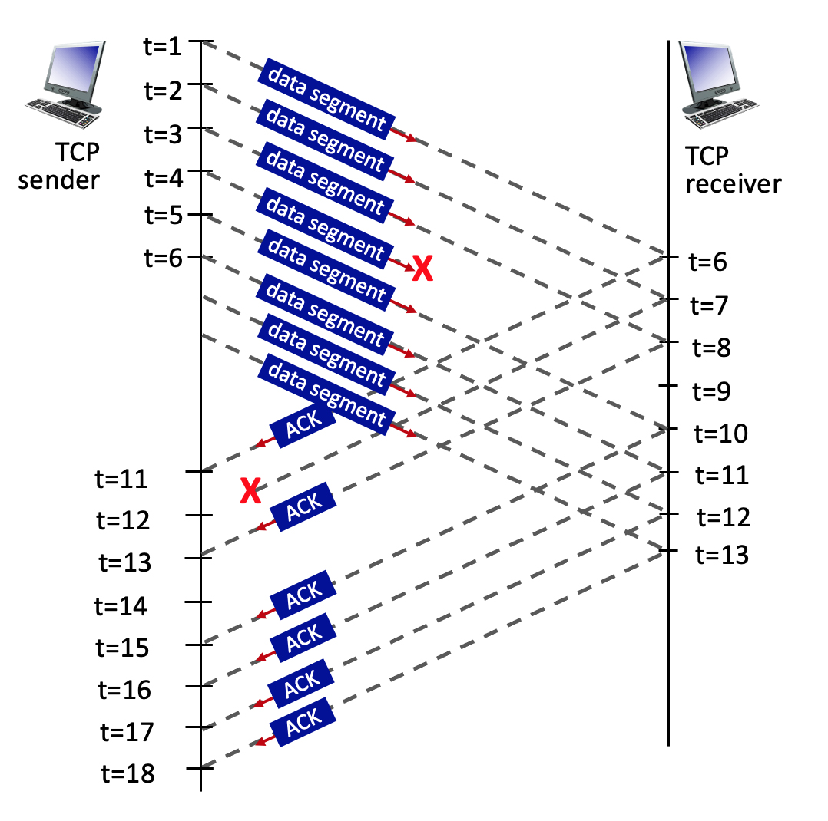
3.5-2a. TCP sequence and ACK numbers.
Consider the figure, where a TCP sender sends 8 TCP segments at t = 1, 2, 3, 4, 5, 6, 7, 8. Suppose the initial value of the sequence number is 0 and every segment sent to the receiver each contains 100 bytes. The delay between the sender and receiver is 5 time units, and so the first segment arrives at the receiver at t = 6. The ACKs sent by the receiver at t = 6, 7, 8, 10, 11, 12 are shown. The TCP segments (if any) sent by the sender at t = 11, 13, 15, 16, 17, 18 are not shown. The segment sent at t=4 is lost, as is the ACK segment sent at t=7.
Q: What is the sequence number of the segment sent at t=2?
A: 0+100=100.
See notes for explanations
Notes:
TCP uses sequence numbers to keep track of the bytes sent in a data stream. Each byte of data is assigned a unique sequence number.
## Given Information
- Initial sequence number: 0
- Each segment contains 100 bytes
- Segments are sent at t = 1, 2, 3, 4, 5, 6, 7, 8
## Calculating the Sequence Number
To find the sequence number of the segment sent at t=2, we need to consider the following:
1. The initial sequence number is 0 for the first segment (t=1).
2. Each segment contains 100 bytes.
3. The sequence number for each subsequent segment increases by the number of bytes in the previous segment.
Therefore:
- Segment at t=1: Sequence number = 0
- Segment at t=2: Sequence number = 0 + 100 = 100
## Explanation
The sequence number for the segment sent at t=2 is 100. This is because:
1. The first segment (t=1) starts with sequence number 0.
2. Each segment contains 100 bytes of data.
3. The second segment (t=2) will have a sequence number that is the sum of the initial sequence number (0) and the number of bytes in the first segment (100).
This pattern would continue for subsequent segments:
- Segment at t=3: Sequence number = 100 + 100 = 200
- Segment at t=4: Sequence number = 200 + 100 = 300
And so on.
It's important to note that the lost segment at t=4 and the lost ACK at t=7 do not affect the sequence numbers of the segments being sent. They would, however, impact the retransmission and acknowledgment process in a real TCP connection.

Slide 23
3.5-2b. TCP sequence and ACK numbers.
Consider the figure, where a TCP sender sends 8 TCP segments at t = 1, 2, 3, 4, 5, 6, 7, 8. Suppose the initial value of the sequence number is 0 and every segment sent to the receiver each contains 100 bytes. The delay between the sender and receiver is 5 time units, and so the first segment arrives at the receiver at t = 6. The ACKs sent by the receiver at t = 6, 7, 8, 10, 11, 12 are shown. The TCP segments (if any) sent by the sender at t = 11, 13, 15, 16, 17, 18 are not shown. The segment sent at t=4 is lost, as is the ACK segment sent at t=7.
Q: What is the ACK value carried in the receiver-to-sender ACK sent at t = 6?
A: 0+100=100. By sending this ACK, the receiver is telling the sender: "I've received everything up to byte 99, and I'm now expecting byte 100."
See notes for explanations
Notes:
## Understanding the Scenario
- The initial sequence number is 0.
- 8 TCP segments are sent at t = 1, 2, 3, 4, 5, 6, 7, 8.
- Each segment contains 100 bytes.
- The delay between sender and receiver is 5 time units.
- The segment sent at t=4 is lost.
- We need to determine the ACK value sent by the receiver at t = 6.
## Calculating the ACK Value
1. **Segments Received**: At t = 6, only the first segment (sent at t = 1) has arrived at the receiver due to the 5-unit delay.
2. **Bytes Received**: The first segment contains 100 bytes.
3. **ACK Mechanism**: TCP uses cumulative ACKs, which means it acknowledges all bytes up to the last contiguously received byte.
4. **ACK Value Calculation**:
- Initial sequence number: 0
- Bytes successfully received: 100
- Next expected byte: 0 + 100 = 100
Therefore, the ACK value carried in the receiver-to-sender ACK sent at t = 6 is 100.
## Explanation
The ACK value of 100 indicates that the receiver has successfully received all bytes up to, but not including, byte 100. It's essentially saying, "I've received everything up to byte 99, and I'm now expecting byte 100."
This ACK value makes sense because:
1. Only one segment has been received (the one sent at t = 1).
2. Each segment contains 100 bytes.
3. The receiver is acknowledging the receipt of the first segment and indicating it's ready for the next byte.
It's important to note that even though more segments were sent by the sender, due to the network delay, only the first segment has reached the receiver at t = 6. The lost segment at t = 4 doesn't affect this initial ACK because it hasn't even reached the receiver yet.

Slide 24
3.5-2c. TCP sequence and ACK numbers.
Consider the figure, where a TCP sender sends 8 TCP segments at t = 1, 2, 3, 4, 5, 6, 7, 8. Suppose the initial value of the sequence number is 0 and every segment sent to the receiver each contains 100 bytes. The delay between the sender and receiver is 5 time units, and so the first segment arrives at the receiver at t = 6. The ACKs sent by the receiver at t = 6, 7, 8, 10, 11, 12 are shown. The TCP segments (if any) sent by the sender at t = 11, 13, 15, 16, 17, 18 are not shown. The segment sent at t=4 is lost, as is the ACK segment sent at t=7.
Q: What is the ACK value carried in the receiver-to-sender ACK sent at t = 8?
A: 300. By sending this ACK, the receiver is telling the sender: "I have received everything up to byte 299. Please send me the next byte, which should be 300."
See notes for explanations
Notes:
To solve this TCP sequence and ACK numbers question, let's break down the scenario and analyze it step by step:
## Initial Conditions
- The initial sequence number is 0.
- Each TCP segment contains 100 bytes.
- 8 TCP segments are sent at t = 1, 2, 3, 4, 5, 6, 7, 8.
- The delay between sender and receiver is 5 time units.
- The segment sent at t=4 is lost.
- The ACK sent at t=7 is lost.
## Analysis
### Segment Arrival
The first segment arrives at the receiver at t = 6 due to the 5-unit delay. This means that by t = 8, the receiver has potentially received the segments sent at t = 1, 2, and 3.
### Sequence Numbers
Given that each segment contains 100 bytes and the initial sequence number is 0, the sequence numbers for the first four segments would be:
- Segment 1: 0-99
- Segment 2: 100-199
- Segment 3: 200-299
- Segment 4: 300-399 (but this segment is lost)
### ACK Behavior
TCP uses cumulative ACKs, meaning it acknowledges all bytes up to the ACK number minus one. The receiver will send an ACK for the highest contiguous sequence number it has received.
## Solution
At t = 8, the receiver has successfully received segments 1, 2, and 3. However, segment 4 (sent at t=4) was lost. According to TCP's cumulative ACK principle, the receiver will acknowledge all data it has received contiguously.
Therefore, the ACK value carried in the receiver-to-sender ACK sent at t = 8 will be 300.
This ACK value of 300 indicates:
1. The receiver has successfully received all bytes up to and including byte 299.
2. The next byte the receiver expects is byte 300.
3. This ACK implicitly acknowledges all previous segments (1, 2, and 3).
By sending this ACK, the receiver is telling the sender: "I have received everything up to byte 299. Please send me the next byte, which should be 300."
It's important to note that even though segments 5, 6, and possibly 7 might have arrived by t=8, the receiver cannot acknowledge them yet because segment 4 is missing, breaking the contiguous sequence of received data.

Slide 25
3.5-2d. TCP sequence and ACK numbers.
Consider the figure, where a TCP sender sends 8 TCP segments at t = 1, 2, 3, 4, 5, 6, 7, 8. Suppose the initial value of the sequence number is 0 and every segment sent to the receiver each contains 100 bytes. The delay between the sender and receiver is 5 time units, and so the first segment arrives at the receiver at t = 6. The ACKs sent by the receiver at t = 6, 7, 8, 10, 11, 12 are shown. The TCP segments (if any) sent by the sender at t = 11, 13, 15, 16, 17, 18 are not shown. The segment sent at t=4 is lost, as is the ACK segment sent at t=7.
Q: What is the ACK value carried in the receiver-to-sender ACK sent at t = 10?
A: 300. By sending this ACK, the receiver is telling the sender: "I have received everything up to byte 299. Please send me the next byte, which should be 300."
See notes for explanations
Notes:
To solve this question, let's analyze the TCP sequence and ACK numbers based on the given information:
## Initial Setup
- The initial sequence number is 0.
- Each segment contains 100 bytes.
- The delay between sender and receiver is 5 time units.
- The segment sent at t=4 is lost.
- The ACK sent at t=7 is lost.
## Sequence of Events
1. Segments sent at t=1, 2, 3 arrive at the receiver at t=6, 7, 8 respectively.
2. The receiver acknowledges these segments at t=6, 7, 8.
3. The segment sent at t=4 is lost and doesn't reach the receiver.
4. Segments sent at t=5, 6, 7, 8 arrive at the receiver at t=10, 11, 12, 13 respectively.
## ACK Value Calculation
To determine the ACK value sent at t=10, we need to consider the last successfully received byte in order.
1. The first three segments (sent at t=1, 2, 3) were successfully received and acknowledged.
- These segments cover bytes 0-99, 100-199, and 200-299.
2. The segment sent at t=4 was lost, so the next expected byte is 300.
3. Even though segments sent at t=5 have arrived by t=10, TCP uses cumulative ACKs.
Therefore, the ACK value sent at t=10 will be 300.
## Explanation
The ACK value of 300 indicates that the receiver has successfully received all bytes up to but not including byte 300. It's requesting the next expected byte, which is 300. This ACK serves two purposes:
1. It acknowledges the receipt of the first three segments.
2. It informs the sender that there's a gap in the received data, prompting a retransmission of the lost segment (sent at t=4).
Even though the receiver has likely received segments sent after the lost one, it cannot acknowledge them yet due to TCP's in-order delivery requirement. This behavior is part of TCP's reliable data transfer mechanism, ensuring that all data is received in the correct order.

Slide 26
Quiz
Host A
Host B
Host A
Host B
1. HostB receives Seq# 92-191 (100 Bytes), and expects the next received Seq# to be 192
1. HostB receives Seq# 92-191 (100 Bytes), and expects the next received Seq# to be 192
Seq=92, 100 bytes of data
Seq=92, 100 bytes of data
timeout
timeout
ACK=192
ACK192
X
2. HostA times out and resends Seq# 92-191 (100 Bytes).
2. HostA sends Seq# 192-291 (100 Bytes).
Seq=92, 100 bytes of data
3. HostB receives Seq# 92-191 (100 Bytes), and expects the next received Seq# to be 192
Seq=192, 100 bytes of data
2. HostB receives Seq# 192-291 (100 Bytes), and expects the next received Seq# to be 292
ACK=192
ACK=292
Received ACK scenario
lost ACK scenario

Slide 27
Quiz
Host A
Host B
1. HostB receives Seq# 92-191 (100 Bytes), and expects the next received Seq# to be 192
Seq=92, 100 bytes of data
timeout
Seq=192, 100 bytes of data
3. HostA receives ACK for Seq# 292. This cumulative ACK of Seq# 292 covers for earlier lost ACK of Seq#192, so HostA knows that HostB has received all bytes up to Seq#291, so it can send the next 100 Bytes
ACK=192
X
2. HostB receives Seq# 192-291 (100 Bytes), and expects the next received Seq# to be 292
ACK=292
Seq=292, 100 bytes of data
ACK=392
Cumulative ACK scenario

Slide 28
Chapter 4 Network Layer:
Data Plane
Computer Networking: A Top-Down Approach 8th edition Jim Kurose, Keith Ross Pearson, 2020
Acknowledgement: Based on the textbook’s website: https://gaia.cs.umass.edu/kurose_ross/index.php
Notes:
Version History
8.0 (May 2020)
All slides reformatted for 16:9 aspect ratio
All slides updated to 8th edition material
Use of Calibri font, rather that Gill Sans MT
Add LOTS more animation throughout
added new 8th edition material on middleboxes (and Internet arch), Net neutrality, buffering …
lighter header font
8.2 (July 2023), changes from 8.0:
some minor updates (e.g., IPv6 stats updated) but not much has changed.

Slide 29
Packet Scheduling: FCFS
IMPORTANT
packet scheduling: deciding which packet to send next on link
first come, first served
priority
round robin
weighted fair queueing
FCFS: packets transmitted in order of arrival to output port
also known as: First-in-first-out (FIFO)
real world examples?
Abstraction: queue
R
packet
departures
packet
arrivals
queue
(waiting area)
link
(server)

Slide 30
Scheduling policies: priority
IMPORTANT
Priority scheduling:
arriving traffic classified, queued by class
any header fields can be used for classification
high priority queue
arrivals
classify
link
departures
low priority queue
2
send packet from highest priority queue that has buffered packets
FCFS within priority class
1
3
4
5
arrivals
packet in service
1
3
2
4
5
departures
1
3
2
4
5

Slide 31
Scheduling policies: round robin
IMPORTANT
Round Robin (RR) scheduling:
arriving traffic classified, queued by class
any header fields can be used for classification
server cyclically, repeatedly scans class queues, sending one complete packet from each class (if available) in turn
R
classify
arrivals
link
departures

Slide 32
Scheduling policies: weighted fair queueing
IMPORTANT
Weighted Fair Queuing (WFQ):
generalized Round Robin
each class, i, has weight, w_{i}, and gets weighted amount of service in each cycle:
w₁
w₂
R
w_{i}
Σ_{j}w_{j}
classify
arrivals
link
departures
w₃
minimum bandwidth guarantee (per-traffic-class)

Slide 33
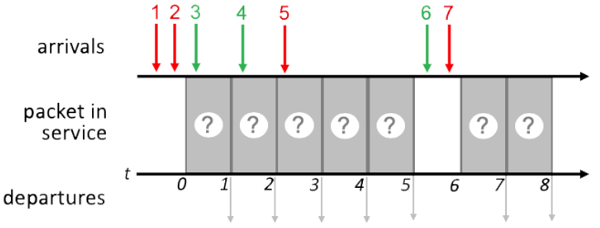
Quiz 1 4.2-7
IMPORTANT

Slide 34
FCFS Scheduling
IMPORTANT
Transmit order the same as packet arrival order of 1 2 3 4 5 6 7
1
2
3
4
5
6
7
1
2
3
4
5
6
7
1 2 3 4 5 6 7

Slide 35
Priority Scheduling
IMPORTANT
Time 0: 1, 2 in queue, transmit 1
FCFS within same priority
Time 1: 2, 3 in queue, transmit 2
Time 2: 3, 4 in queue, transmit 3
FCFS within same priority
Time 3: 4, 5 in queue, transmit 5
Time 4: 4 in queue, transmit 4
Time 6: 6, 7 in queue, transmit 7
Time 7: 6 in queue, transmit 6
1
2
3
5
4
7
6
1
2
3
5
4
7
6
1 2 3 5 4 7 6
Network Layer: 4-35

Slide 36
Round Robin Scheduling
IMPORT
Assume a round-robin scheduling cycle begins with red packets. i.e., (red, green) in each round.
Time 0: 1, 2 in queue, transmit 1
1st round of (red, green)
Time 1: 2, 3 in queue, transmit 3
1st round of (red, green)
Time 2: 2. 4 in queue, transmit 2
2nd round of (red, green)
Time 3: 4, 5 in queue, transmit 4
2nd round of (red, green)
Time 4: 5 in queue, transmit 5
3RD round of (red, green). Since there is no green packet ready, this round is (red, null)
Time 6: 6, 7 in queue, transmit 7
4th round of (red, green)
Time 7: 6 in queue, transmit 6
4th round of (red, green)
Summary:
Times 0-1: 1st round: (1, 3)
Times 2-3: 2nd round: (2, 4)
Time 4: 3rd round: (5, null)
No green packets ready
Times 6-7: 4th round: (7, 6)
1
3
2
4
5
7
6
1
3
2
4
5
7
6
1 3 2 4 5 7 6

Slide 37
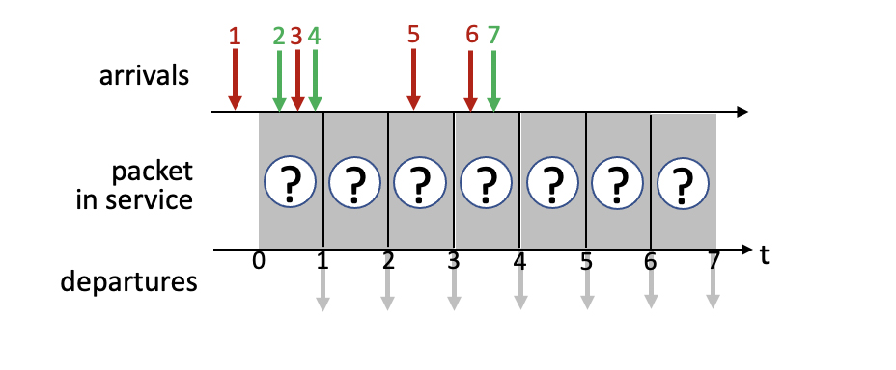
Quiz 2 4.2-3

Slide 38
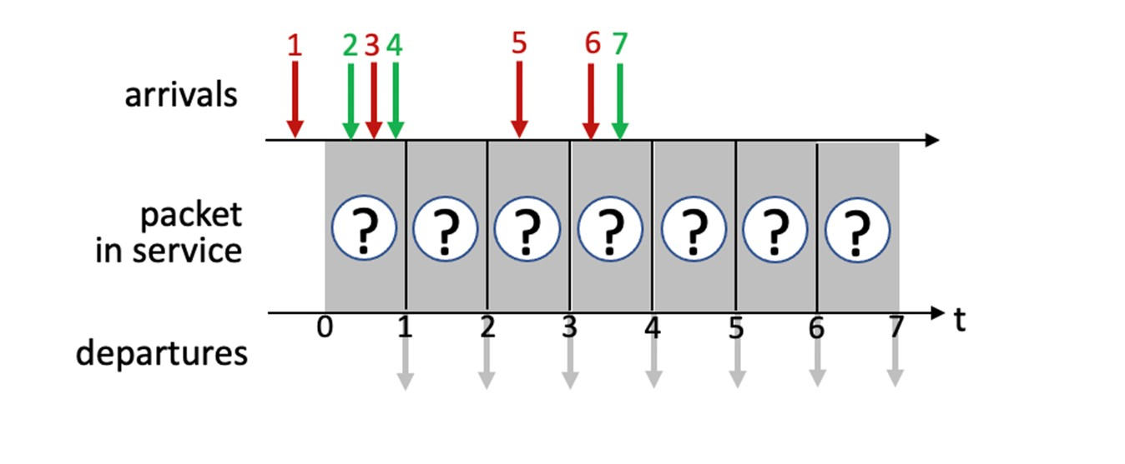
FCFS Scheduling
IMPORTANT
Transmit order the same as packet arrival order of 1 2 3 4 5 6 7
1
2
3
4
5
6
7
1
2
3
4
5
6
7
1 2 3 4 5 6 7

Slide 39
Priority Scheduling
IMPORTANT
Time 0: 1 in queue, transmit 1
Time 1: 2, 3, 4 in queue, transmit 3
Time 2: 2, 4 in queue, transmit 2
FCFS within same priority
Time 3: 4, 5 in queue, transmit 5
Time 4: 4, 6, 7 in queue, transmit 6
Time 5: 4, 7 in queue, transmit 4
Time 6: 7 in queue, transmit 7
1
3
2
5
6
4
7
1
3
2
5
6
4
7
1 3 2 5 6 4 7
Network Layer: 4-39

Slide 40
Round Robin Scheduling
IMPORTANT
Assume a round-robin scheduling cycle begins with red packets. i.e., (red, green) in each round.
Summary:
Times 0-1: 1st round: (1, 2)
Times 2-3: 2nd round: (3, 4)
Times 4-5: 3rd round: (5, 7)
No green packets ready
Time 6: 4th round: (6, null)
1
2
3
4
5
7
6
1
2
3
4
5
7
6
1 2 3 4 5 7 6

Slide 41
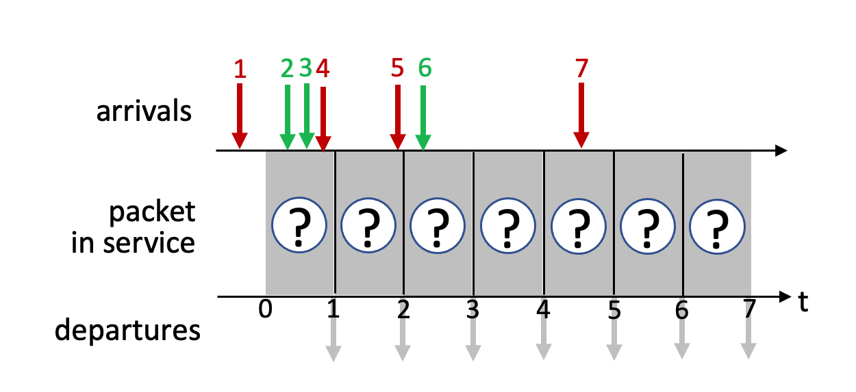
Quiz 3 4.2-4

Slide 42
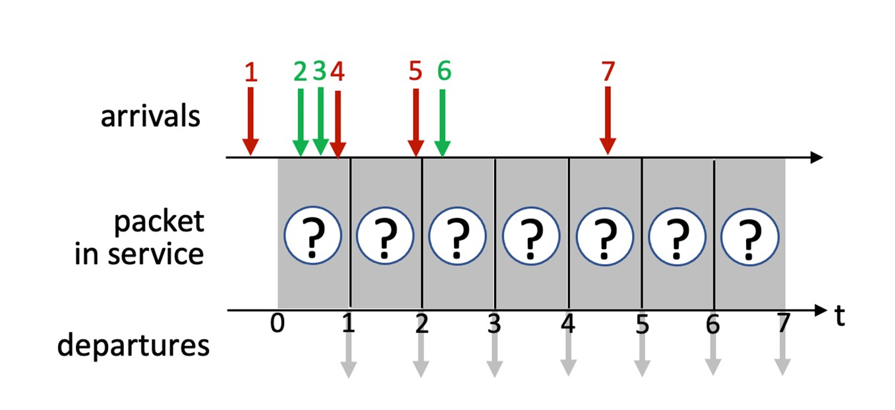
FCFS Scheduling
IMPORTANT
Transmit order the same as packet arrival order of 1 2 3 4 5 6 7
1
2
3
4
5
6
7
1
2
3
4
5
6
7
1 2 3 4 5 6 7

Slide 43
Priority Scheduling
IMPORTANT
Time 0: 1 in queue, transmit 1
Time 1: 2, 3, 4 in queue, transmit 4
Time 2: 2, 3, 5 in queue, transmit 5
Time 3: 2, 3, 6 in queue, transmit 2
Time 4: 3, 6 in queue, transmit 3
Time 5: 6, 7 in queue, transmit 7
Time 6: 6 in queue, transmit 6
1
4
5
2
3
7
6
1
4
5
2
3
7
6
1 4 5 2 3 7 6
Network Layer: 4-43

Slide 44
Round Robin Scheduling
IMPORTANT
Assume a round-robin scheduling cycle begins with red packets. i.e., (red, green) in each round.
Summary:
Times 0-1: 1st round: (1, 2)
Times 2-3: 2nd round: (4, 3)
Times 4-5: 3rd round: (5, 6)
No green packets ready
Time 6: 4th round: (7, null)
1
2
4
3
5
6
7
1
2
4
3
5
6
7
1 2 4 3 5 6 7

Slide 45
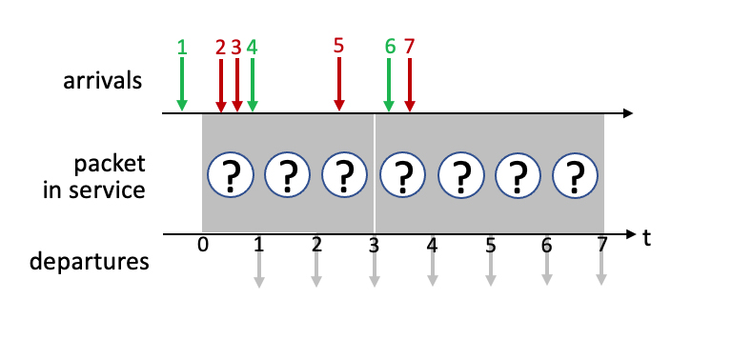
Quiz 4 4.2-1

Slide 46
Quiz 4 4.2-1 Priority
1
2
3
5
7
4
6
1
2
3
5
7
4
6

Slide 47
Quiz 4 4.2-1 Round Robin
Assume a round-robin scheduling cycle begins with red packets. i.e., (red, green) in each round.
Summary:
Times 0: 1st round: (null, 1)
Times 1-2: 2nd round: (2, 4)
Times 3-4: 3rd round: (3, 6)
No green packets ready
Time 5: 4th round: (5, null)
Time 6: 5th round: (7, null)
1
2
4
3
6
5
7
1
2
4
3
6
5
7

Slide 48
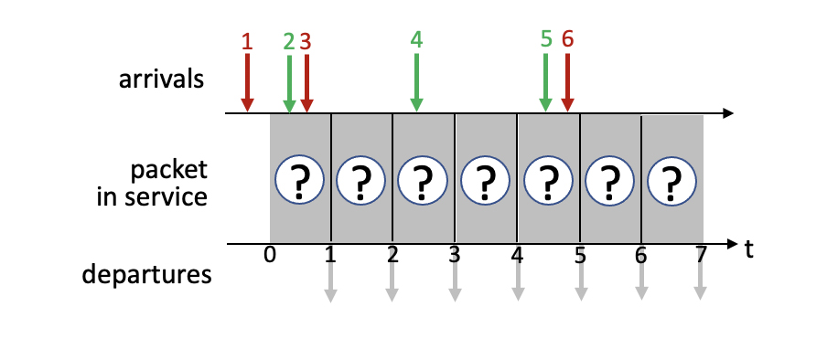
Quiz 5 4.2-2

Slide 49
Quiz 5 4.2-2 Priority
1
3
2
4
6
5
1
3
2
4
6
5

Slide 50
Quiz 5 4.2-2 Round Robin
Assume a round-robin scheduling cycle begins with red packets. i.e., (red, green) in each round.
Summary:
Times 0: 1st round: (1, 2)
Times 1-2: 2nd round: (3, 4)
Times 5-6: 3rd round: (6, 5)
1
2
3
4
6
5
1
2
3
4
6
5

Slide 51
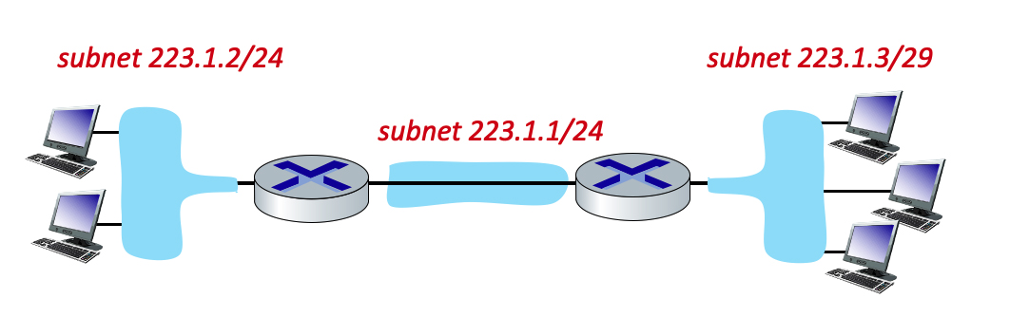
Question 4.3-05ab
4.3-05. Subnetting(a). Consider the three subnets in the diagram below.
1. What is the maximum # of interfaces in the 223.1.2/24 network?
2. What is the maximum # of interfaces in the 223.1.3/29 network?
Including the network address (all host bits in the IP address equal to 0) and broadcast address (all host bits in the IP address equal to 1).
1 ANS: In 223.1.2/24
Network, since 32-24
=8 bits for host address,
Hence maximum # of
Interfaces = 2⁸=256
2 ANS: In 223.1.3/29
Network, since 32-29
=3 bits for host address,
Hence maximum # of
Interfaces = 2³=8
subnet
part
host
part
24 bits
8 bits
29 bits
3 bits

Slide 52
Question 4.3-05c
4.3-05. Subnetting(a). Consider the three subnets in the diagram below.
3. Which of the following addresses cannot be used by an interface in the 223.1.3/29 network? Check all that apply.
223.1.3.6, 223.1.3.2, 223.1.3.16, 223.1.2.6, 223.1.3.28
3 ANS: In 223.1.3/29
Network, since 32-29
=3 bits for host address,
Hence maximum # of
Interfaces = 2³=8, ranging
From 0 to 7. Hence
223.1.3.6, 223.1.3.2 are OK
223.1.3.16, 223.1.3.28 are not OK
since the host ID exceeds 7
223.1.2.6 is not OK since network address
223.1.2 does not match 223.1.3
subnet
part
host
part
24 bits
8 bits
29 bits
3 bits

Slide 53
NAT: network address translation
IMPORTANT
NAT: all devices in local network share just one IPv4 address as far as outside world is concerned
rest of
Internet
local network (e.g., home network) 10.0.0/24
10.0.0.1
138.76.29.7
10.0.0.4
10.0.0.2
10.0.0.3
all datagrams leaving local network have same source NAT IP address: 138.76.29.7, but different source port numbers
datagrams with source or destination in this network have 10.0.0/24 address for source, destination (as usual)

Slide 54
NAT: network address translation
IMPORTANT
all devices in local network have 32-bit addresses in a “private” IP address space (10/8, 172.16/12, 192.168/16 prefixes) that can only be used in local network
advantages:
just one IP address needed from provider ISP for all devices
can change addresses of host in local network without notifying outside world
can change ISP without changing addresses of devices in local network
security: devices inside local net not directly addressable, visible by outside world

Slide 55
NAT: network address translation
IMPORTANT
implementation: NAT router must (transparently):
outgoing datagrams: replace (source IP address, port #) of every outgoing datagram to (NAT IP address, new port #)
remote clients/servers will respond using (NAT IP address, new port #) as destination address
remember (in NAT translation table) every (source IP address, port #) to (NAT IP address, new port #) translation pair
incoming datagrams: replace (NAT IP address, new port #) in destination fields of every incoming datagram with corresponding (source IP address, port #) stored in NAT table

Slide 56
NAT: network address translation
IMPORTANT
NAT translation table
WAN side addr LAN side addr
2: NAT router changes datagram source address from 10.0.0.1, 3345 to 138.76.29.7, 5001,
updates table
1: host 10.0.0.1 sends datagram to 128.119.40.186, 80
138.76.29.7, 5001 10.0.0.1, 3345
…… ……
S: 10.0.0.1, 3345
D: 128.119.40.186, 80
10.0.0.1
1
2
S: 138.76.29.7, 5001
D: 128.119.40.186, 80
10.0.0.4
10.0.0.2
138.76.29.7
S: 128.119.40.186, 80
D: 10.0.0.1, 3345
4
S: 128.119.40.186, 80
D: 138.76.29.7, 5001
3
10.0.0.3
3: reply arrives, destination address: 138.76.29.7, 5001

Slide 57
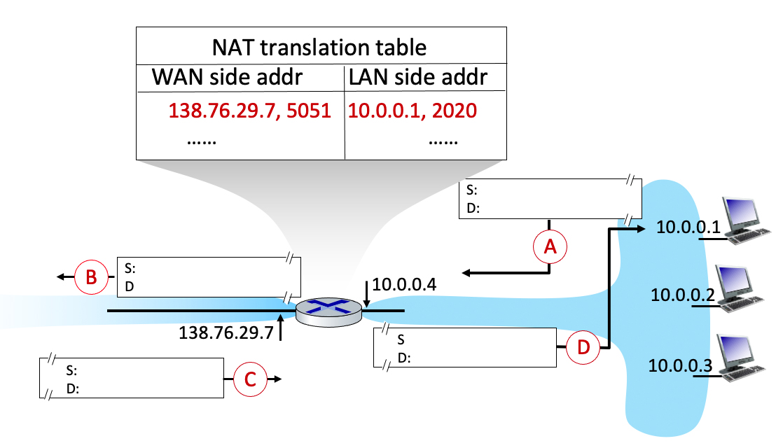
Quiz
4.3-2a Network Address Translation (a). Consider the following scenario in which host 10.0.0.1 is communicating with an external web server at IP address 128.119.40.186, port 80. The NAT table shows the table entry associated with this TCP flow. What are the source and destination IP address and port numbers at points A B C D?

Slide 58
`
S: 10.0.0.1, 2020
D: 128.119.40.186, 80
S: 138.76.29.7, 5051
D: 128.119.40.186, 80
S: 128.119.40.186, 80
D: 10.0.0.1, 2020
S: 128.119.40.186, 80
D: 138.76.29.7, 5051

Slide 59
Chapter 5 Network Layer:
Control Plane
Computer Networking: A Top-Down Approach 8th edition Jim Kurose, Keith Ross Pearson, 2020
Acknowledgement: Based on the textbook’s website: https://gaia.cs.umass.edu/kurose_ross/index.php
Notes:
Version History
8.0 (May 2020)
All slides reformatted for 16:9 aspect ratio
All slides updated to 8th edition material
Use of Calibri font, rather that Gill Sans MT
Add LOTS more animation throughout
lighter header font
Re-do of network management slides; redo of Bellman-Ford slides
8.2 (changes over 8.0)
improved animations of Dijkstra’s algorithm and Bellman Ford
various improvements to BGP
SDN: added Google Orion (2021 Google network SDN control plane)

Slide 60
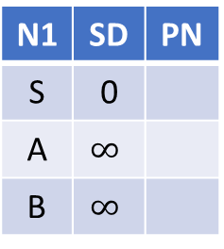
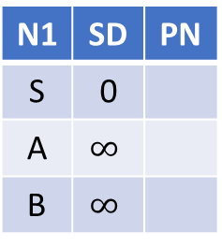
Toy Example: find shortest path starting from source vertex S for undirected graph. Given the graph, fill in the tables SD: Shortest Distance. PN: Previous Node
A
2
S
1
4
B
N1 | SD | PN
S | 0
A | $$∞$$
B | $$∞$$
N1 | SD | PN
S | 0
A | 2 | S
B | 4 | S
N1 | SD | PN
S | 0
A | 2 | S
B | 3 | A
N1 | SD | PN
S | 0
A | 2 | S
B | 3 | A
Visit S
Visit A
Visit B
A
2
S
3
4
B
N1 | SD | PN
S | 0
A | $$∞$$
B | $$∞$$
N1 | SD | PN
S | 0
A | 2 | S
B | 4 | S
N1 | SD | PN
S | 0
A | 2 | S
B | 4 | S
N1 | SD | PN
S | 0
A | 2 | S
B | 4 | S
Visit S
Visit A
Visit B

Slide 61
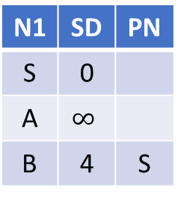
Toy Example: find shortest path starting from source vertex S for directed graph. Given the graph, fill in the tables
A
2
S
1
4
B
N1 | SD | PN
S | 0
A | $$∞$$
B | $$∞$$
N1 | SD | PN
S | 0
A | 2 | S
B | 4 | S
N1 | SD | PN
S | 0
A | 2 | S
B | 4 | S
N1 | SD | PN
S | 0
A | 2 | S
B | 4 | S
Visit S
Visit A
Visit B
A
2
S
1
4
B
N1 | SD | PN
S | 0
A | $$∞$$
B | $$∞$$
N1 | SD | PN
S | 0
A | $$∞$$
B | 4 | S
N1 | SD | PN
S | 0
A | 5 | B
B | 4 | S
N1 | SD | PN
S | 0
A | 5 | B
B | 4 | S
Visit S
Visit B
Visit A

Slide 62
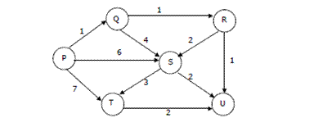
Dijkstra’s Algorithm Example 4
Suppose we run Dijkstra’s single source shortest-path algorithm on the following edge weighted directed graph with vertex P as the source. In what order do the vertices get included into the set of vertices for which the shortest path distances are finalized? Given the graph, fill in the tables.
ANS: P, Q, R, U, S, T

Slide 63
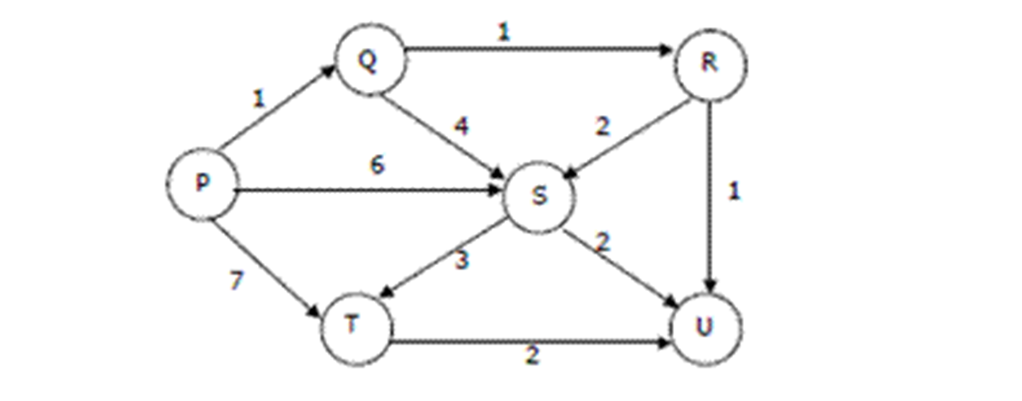
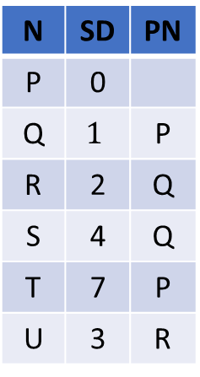
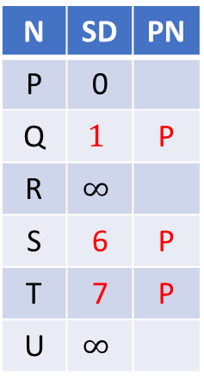

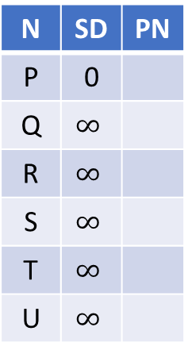
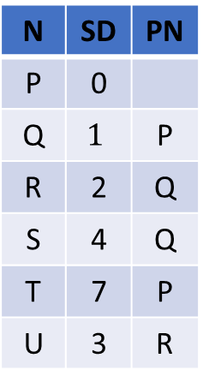
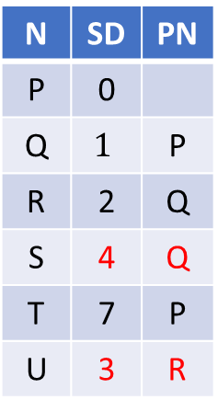
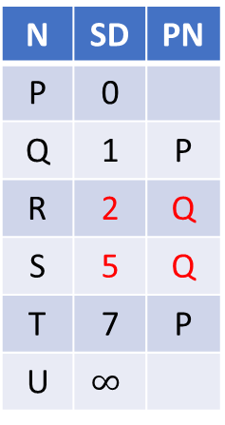

SD: Shortest Distance
PN: Previous vertex
N | SD | PN
P | 0
Q | $$∞$$
R | $$∞$$
S | $$∞$$
T | $$∞$$
U | $$∞$$
N | SD | PN
P | 0
Q | $$1$$ | P
R | $$∞$$
S | 6 | P
T | 7 | P
U | $$∞$$
N | SD | PN
P | 0
Q | 1 | P
R | 2 | Q
S | 5 | Q
T | 7 | P
U | $$∞$$
N | SD | PN
P | 0
Q | $$1$$ | P
R | 2 | Q
S | 4 | Q
T | 7 | P
U | 3 | R
Visit P
Visit Q
Visit R
Visit U (nothing changes)
N | SD | PN
P | 0
Q | $$1$$ | P
R | 2 | Q
S | 4 | Q
T | 7 | P
U | 3 | R
N | SD | PN
P | 0
Q | $$1$$ | P
R | 2 | Q
S | 4 | Q
T | 7 | P
U | 3 | R
N | SD | PN
P | 0
Q | $$1$$ | P
R | 2 | Q
S | 4 | Q
T | 7 | P
U | 3 | R
N | SD | PN
P | 0
Q | $$1$$ | P
R | 2 | Q
S | 4 | Q
T | 7 | P
U | 3 | R
Visit S
Visit T
Finished
(nothing
changes)
(nothing
changes)

Slide 64
Chapter 6 The Link Layer
and LANs
Computer Networking: A Top-Down Approach 8th edition Jim Kurose, Keith Ross Pearson, 2020
Acknowledgement: Based on the textbook’s website: https://gaia.cs.umass.edu/kurose_ross/index.php
Notes:
Version History
8.0 (May 2020)
All slides reformatted for 16:9 aspect ratio
All slides updated to 8th edition material
Use of Calibri font, rather that Gill Sans MT
Add LOTS more animation throughout
lighter header font
Updated datacenter slides, day-in-the-life
8.2 (July 2023): changes from 8.0
Minor updates throughout, including removal of master/slave
A few new slides added (transportation analogy, UMass LAN example, extended LANs)
Couple of not-used slides now hidden.

Slide 65
Quiz: Number of Parity Errors
IMPORTANT
no errors:
1 0 1 0 1
1
1 0 1 0 1 1
1 0 1 0 1 1
1 0 1 0 0 0
parity
error
1 1 1 1 0
0
1 0 1 1 0 1
parity
error
1 0 1 1 1 0
1 0 1 1 0 1
parity
error
0 1 1 1 0
1
0 1 1 1 0 1
0 1 1 1 0 1
0 1 1 1 1 0
parity
error
0 0 1 0 1
0
0 1 1 0 1 0
0 1 1 0 0 0
0 1 1 0 1 0
parity
error
parity
error
parity
error
parity
error
1-bit error causes 1 row parity error, 1 column parity error
2-bit error causes 2 row parity errors
3-bit error causes
_3_row parity errors
_1_column parity errors
_0_corner parity errors
1 1 1 0 0 1
1 0 1 0 1
1
1 0 1 0 1
1
1 0 1 0 1
1
1 1 1 1 0 0
1 1 1 1 0
0
1 1 1 1 0
0
1 1 1 1 0
0
0 0 1 1 1 1
0 1 1 1 0
1
0 1 1 1 0
1
0 1 1 1 0
1
0 0 1 0 1 0
0 0 1 0 1
0
0 0 1 0 1
0
0 0 1 0 1
0
4-bit error causes NO parity error, hence cannot be detected
2-bit error causes
_2_row parity errors
_2_column parity errors
_0_corner parity errors
3-bit error causes
_3_row parity errors
_3_column parity errors
_0_corner parity errors
4-bit error causes
_2_row parity errors
_4_column parity errors
_0_corner parity errors
Notes:
4
7
6

Slide 66
Cyclic Redundancy Check (CRC): Example 1
G
Sender wants to compute R such that for some integer n:
D . 2^{r} XOR R = nG
1
0
1
0 1 1
1 0 0 1
1 0 1 1 1 0
0 0 0
1 0 0 1
1 0 1
D
2^{r} (here, r=3)
... or equivalently (XOR R both sides):
D . 2^{r} = nG XOR R
*
0 0 0
1 0 1 0
... which says:
if we divide D . 2^{r} by G, we want remainder R to satisfy:
1 0 0 1
1 1 0
0 0 0
1 1 0 0
D.2^{r}
G
algorithm for
computing R
1 0 0 1
R = remainder [ ]
1 0 1 0
1 0 0 1
Example: D=101110, G=1001, r=3
D . 2^{r} = 101110000 → R=011
0 1 1
R
* Check out the online interactive exercises for more examples: http://gaia.cs.umass.edu/kurose_ross/interactive/

Slide 67
Cyclic Redundancy Check (CRC): Example 1 Cont
G
1
0
1
0 1 1
Add remainder to D . 2^{r}
D . 2^{r} + R = D . 2^{r} XOR R
= 101110000 XOR 011
= 101110011
It must be divisible by G=1001, i.e. remainder of the division is 0,
D . 2^{r} R is divisible by G, or
D . 2^{r} XOR R = nG
1 0 0 1
1 0 1 1 1 0
0 1 1
1 0 0 1
1 0 1
D
2^{r}+R (here, r=3)
0 0 0
*
1 0 1 0
1 0 0 1
1 1 0
0 0 0
1 1 0 1
1 0 0 1
1 0 0 1
1 0 0 1
0 0 0
R

Slide 68
Cyclic Redundancy Check (CRC): Example 2
G
Sender wants to compute R such that for some integer n:
D . 2^{r} XOR R = nG
1
1
1
1 0 1
1 1 0 1
1 0 0 1 0 0
0 0 0
1 1 0 1
1 0 0 0
... or equivalently (XOR R both sides):
D . 2^{r} = nG XOR R
1 1 0 1
1 0 1 0
... which says:
if we divide D . 2^{r} by G, we want remainder R to satisfy:
1 1 0 1
1 1 1 0
1 1 0 1
0 1 1 0
D.2^{r}
G
algorithm for
computing R
0 0 0 0
R = remainder [ ]
1 1 0 0
1 1 0 1
Example: D=100100, G=1101, r=3
D . 2^{r} = 100100000, R=001
0 0 1
R

Slide 69
Cyclic Redundancy Check (CRC): Example 2 Cont
G
1
1
1
1 0 1
Add remainder to D . 2^{r}
D . 2^{r} + R = D . 2^{r} XOR R
= 100100000 XOR 001
= 100100001
It must be divisible by G=1101, i.e. remainder of the division is 0,
D . 2^{r} R is divisible by G, or
D . 2^{r} XOR R = nG
1 1 0 1
1 0 0 1 0 0
0 0 1
1 1 0 1
1 0 0 0
1 1 0 1
1 0 1 0
1 1 0 1
1 1 1 0
1 1 0 1
0 1 1 0
0 0 0 0
1 1 0 1
1 1 0 1
0 0 0
R
* Check out the online interactive exercises for more examples: http://gaia.cs.umass.edu/kurose_ross/interactive/

Slide 70
Cyclic Redundancy Check (CRC): Example 3
G
Example 2: D=1011010010, G=110010, r=5
D . 2^{r} = 101101001000000
→ R=01000
1 1 0 1 0 0 0 1 0 0
1 1 0 0 1 0
1 0 1 1 0 1
0 0 1 0 0 0 0 0 0
1 1 0 0 1 0
1 1 1 1 1 0
1 1 0 0 1 0
1 1 0 0 0 1
1 1 0 0 1 0
1 1 0 0 0 0
1 1 0 0 1 0
0 1 0 0 0
R
Error Detection and Correction 2: Cyclic Redundancy Check
https://www.youtube.com/watch?v=6gbkoFciryA

Slide 71
Cyclic Redundancy Check (CRC): Example 3 Cont
G
1 1 0 1 0 0 0 1 0 0
1 1 0 0 1 0
1 0 1 1 0 1
0 0 1 0 0 1 0 0 0
D . 2^{r} + R = D . 2^{r} XOR R
= 101101001000000 XOR 01000
= 101101001001000
It must be divisible by G= 110010, i.e. remainder of the division is 0,
D . 2^{r} XOR R is divisible by G, or
D . 2^{r} XOR R = nG
1 1 0 0 1 0
1 1 1 1 1 0
1 1 0 0 1 0
1 1 0 0 0 1
1 1 0 0 1 0
1 1 0 0 1 0
1 1 0 0 1 0
0 0 0 0 0
R

Slide 72
Video Tutorials
Error Detection
https://www.youtube.com/watch?v=EMrY-8m8D1E&list=PLBlnK6fEyqRgMCUAG0XRw78UA8qnv6jEx&index=44
Vertical Redundancy Check (VRC)
https://www.youtube.com/watch?v=UwERCzJv-y8&list=PLBlnK6fEyqRgMCUAG0XRw78UA8qnv6jEx&index=45
Longitudinal Redundancy Check (LRC)
https://www.youtube.com/watch?v=nNONvBsOtrE&list=PLBlnK6fEyqRgMCUAG0XRw78UA8qnv6jEx&index=46
Checksum
https://www.youtube.com/watch?v=AtVWnyDDaDI&list=PLBlnK6fEyqRgMCUAG0XRw78UA8qnv6jEx&index=47
Cyclic Redundancy Check (CRC) - Part 1 (This is Example 2)
https://www.youtube.com/watch?v=A9g6rTMblz4&list=PLBlnK6fEyqRgMCUAG0XRw78UA8qnv6jEx&index=48
Cyclic Redundancy Check (CRC) - Part 2 (This is Example 2 Cont)
https://www.youtube.com/watch?v=wQGwfBS3gpk&list=PLBlnK6fEyqRgMCUAG0XRw78UA8qnv6jEx&index=49
Cyclic Redundancy Check (Solved Problem)
https://www.youtube.com/watch?v=tEkePtlujSA&list=PLBlnK6fEyqRgMCUAG0XRw78UA8qnv6jEx&index=50
Error Detection and Correction 2: Cyclic Redundancy Check (This is Example 3)
https://www.youtube.com/watch?v=6gbkoFciryA

Slide 73
Quiz 1 Parity Checking
IMPORTANT
Q: Compute the parity bits for the following data matrix:
1 0 1
0 1 0
1 1 1
A:
1 0 1 | 0
0 1 0 | 1
1 1 1 | 1
------------
0 0 0 | 0
Q: Compute the parity bits for the following data matrix:
1 0 1
0 0 0
1 0 1
A:
1 0 1 | 0
0 0 0 | 0
1 0 1 | 0
------------
0 0 0 | 0

Slide 74
Quiz 2 Internet checksum
IMPORTANT
Q: Suppose that a packet 1001 1100 1010 0011 is transmitted using Internet checksum (N=4-bit integer). What is the value of the checksum? Show your calculation process.
A: One’s complement sum for 4-bit integers is defined as sum modulo 2^{N}, N=4, and adding any overflow of high order bits back into low-order bits, then taking one’s complement.
0011+1010 = 1101
1101+1100 = 1001+1 = 1010
1010+1001 = 0011+1 = 0100.
So, the Internet checksum is 1011, the one’s complement of 0100.
You can also do it in one step as shown on the right.
1 0 0 1
1 1 0 0
1 0 1 0
0 0 1 1
10 0 0 1 0
1 0
0 1 0 0

Slide 75
Quiz 3 CRC
IMPORTANT
Q: A bit stream 1001 is transmitted using the standard CRC method. The generator is 1011. Show the actual bit string transmitted. Suppose that the first bit sent is inverted during transmission error. Show that this error is detected at the receiver’s end. Give an example of bit errors in the bit string transmitted that will not be detected by the receiver. Show your calculation process.
A: D=1001, G=1011, r=3. Compute R
The message after appending three zeros is 1001000. The remainder on dividing 1001000 by 1011 is 110. So, the actual bits transmitted are 1001110.
The received bit stream with an error in the first bit is 0001110. Dividing this by 1011 produces a remainder of 101, which is different from 0. Thus, the receiver detects an error.
If the transmitted bit stream is converted to any multiple of 1001, the error will not be detected. A trivial example is if all ones in the bit stream are inverted to 0.

Slide 76
Quiz 4 CRC
IMPORTANT
D=110011, G=1001, r=3. Compute R. Show your calculation process.
D=1001100, G=1011, r=3. Compute R. Show your calculation process.

Slide 77
Chapter 7 Wireless and
Mobile Networks
Computer Networking: A Top-Down Approach 8th edition Jim Kurose, Keith Ross Pearson, 2020
Acknowledgement: Based on the textbook’s website: https://gaia.cs.umass.edu/kurose_ross/index.php
Notes:
Version History
8.0 (May 2020)
All slides reformatted for 16:9 aspect ratio
All slides updated to 8th edition material
Use of Calibri font, rather that Gill Sans MT
Add LOTS more animation throughout
lighter header font
4G/5G material completely updated; older 2/2.5/3G removed
8.2 (July 2023). Changes from 8.0:
minor updates and additional, including removing master/slave Bluetooth language
expansion, better graphics on wireless link characteristics
expanded, significant revisions of 4G/5G material (but not mobility)

Slide 78
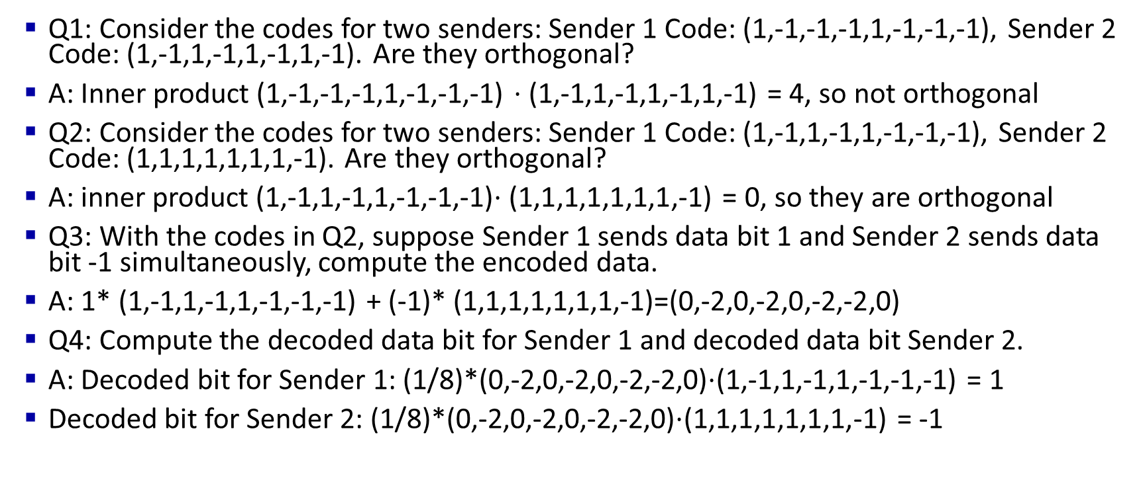
Quiz 1 CDMA
IMPORTANT
Q1: Consider the codes for two senders: Sender 1 Code: (1,-1,-1,-1,1,-1,-1,-1), Sender 2 Code: (1,-1,1,-1,1,-1,1,-1). Are they orthogonal?
A: Inner product (1,-1,-1,-1,1,-1,-1,-1) $⋅$(1,-1,1,-1,1,-1,1,-1) = 4, so not orthogonal
Q2: Consider the codes for two senders: Sender 1 Code: (1,-1,1,-1,1,-1,-1,-1), Sender 2 Code: (1,1,1,1,1,1,1,-1). Are they orthogonal?
A: inner product (1,-1,1,-1,1,-1,-1,-1)$⋅$(1,1,1,1,1,1,1,-1) = 0, so they are orthogonal
Q3: With the codes in Q2, suppose Sender 1 sends data bit 1 and Sender 2 sends data bit -1 simultaneously, compute the encoded data.
A: 1* (1,-1,1,-1,1,-1,-1,-1) + (-1)* (1,1,1,1,1,1,1,-1)=(0,-2,0,-2,0,-2,-2,0)
Q4: Compute the decoded data bit for Sender 1 and decoded data bit Sender 2.
A: Decoded bit for Sender 1: (1/8)*(0,-2,0,-2,0,-2,-2,0)$⋅$(1,-1,1,-1,1,-1,-1,-1) = 1
Decoded bit for Sender 2: (1/8)*(0,-2,0,-2,0,-2,-2,0)$⋅$(1,1,1,1,1,1,1,-1) = -1

Slide 79
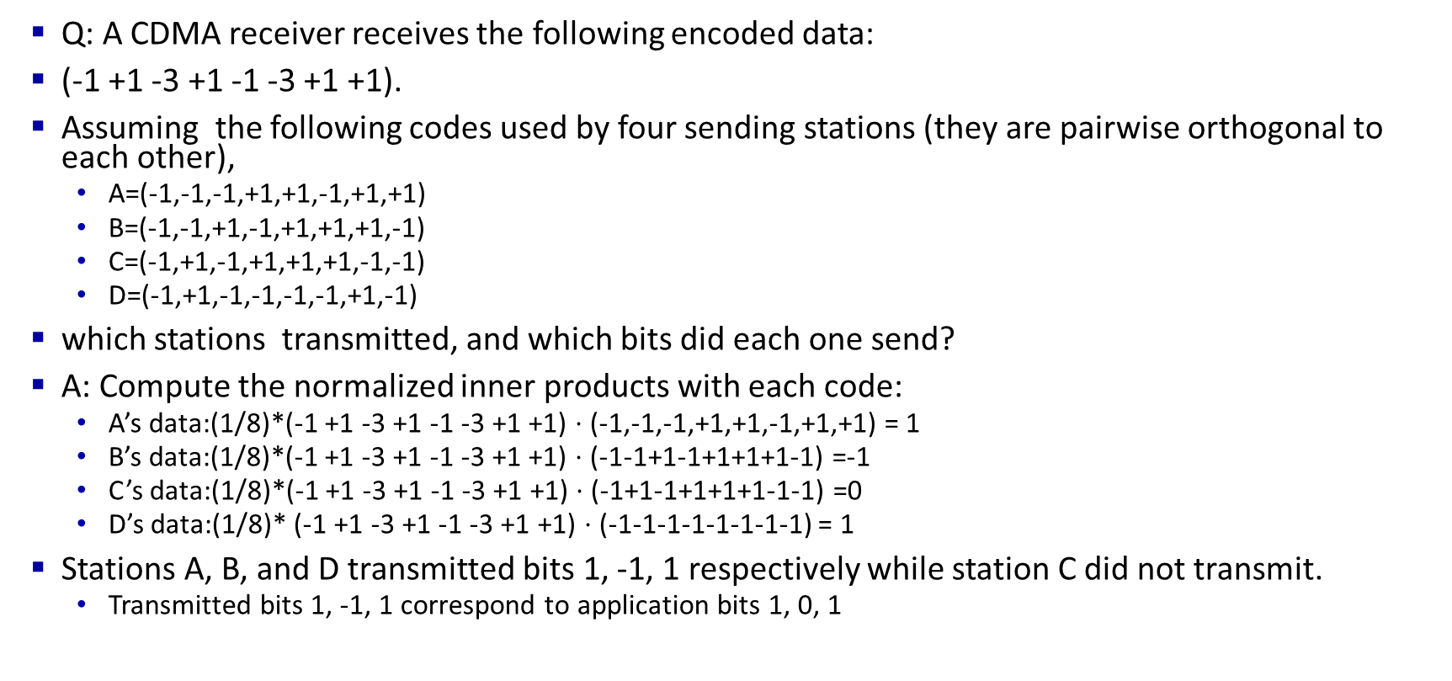
Quiz 2 CDMA
IMPORTANT
Q: A CDMA receiver receives the following encoded data:
(-1 +1 -3 +1 -1 -3 +1 +1).
Assuming the following codes used by four sending stations (they are pairwise orthogonal to each other),
A=(-1,-1,-1,+1,+1,-1,+1,+1)
B=(-1,-1,+1,-1,+1,+1,+1,-1)
C=(-1,+1,-1,+1,+1,+1,-1,-1)
D=(-1,+1,-1,-1,-1,-1,+1,-1)
which stations transmitted, and which bits did each one send?
A: Compute the normalized inner products with each code:
A’s data:(1/8)*(-1 +1 -3 +1 -1 -3 +1 +1) $⋅$ (-1,-1,-1,+1,+1,-1,+1,+1) = 1
B’s data:(1/8)*(-1 +1 -3 +1 -1 -3 +1 +1) $⋅$ (-1-1+1-1+1+1+1-1) =-1
C’s data:(1/8)*(-1 +1 -3 +1 -1 -3 +1 +1) $⋅$ (-1+1-1+1+1+1-1-1) =0
D’s data:(1/8)* (-1 +1 -3 +1 -1 -3 +1 +1) $⋅$ (-1-1-1-1-1-1-1-1) = 1
Stations A, B, and D transmitted bits 1, -1, 1 respectively while station C did not transmit.
Transmitted bits 1, -1, 1 correspond to application bits 1, 0, 1

Slide 80
Chapter 8 Security
Computer Networking: A Top-Down Approach 8th edition Jim Kurose, Keith Ross Pearson, 2020
Acknowledgement: Based on the textbook’s website: https://gaia.cs.umass.edu/kurose_ross/index.php
Notes:
Version History
8.0 (May 2020)
All slides reformatted for 16:9 aspect ratio
All slides updated to 8th edition material
Use of Calibri font, rather that Gill Sans MT
Add LOTS more animation throughout
lighter header font
wireless security completely redone (updated WiFi and added 4G/5G)
SSL material replaces by TLS 1.3 (up-to-date)
V8.2 (Feb 2022)
Minor corrections

Slide 81
Quiz: Block Cipher
Consider the 3-bit block cipher in the Table below
Plain | 000 | 001 | 010 | 011 | 100 | 101 | 110 | 111
Cipher | 110 | 111 | 101 | 100 | 011 | 010 | 000 | 001
Suppose the plaintext is 100101100.
Initially assume that CBC is not used. What is the resulting ciphertext?
Suppose Trudy sniffs the ciphertext. Assuming she knows that a 3-bit block cipher without CBC is being employed (but doesn’t know the specific cipher), what can she surmise?
Now, suppose that CBC is used with IV-111. What is the resulting ciphertext?

Slide 82
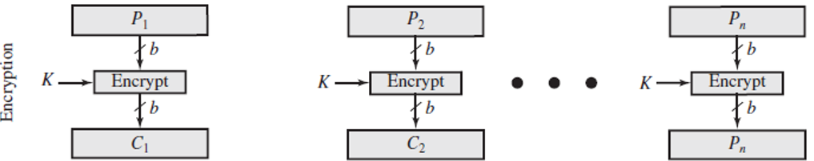
Quiz: Block Cipher ANS
Plain | 000 | 001 | 010 | 011 | 100 | 101 | 110 | 111
Cipher | 111 | 110 | 101 | 100 | 011 | 010 | 000 | 001
Initially assume that CBC is not used. What is the resulting ciphertext?
ANS: Ciphertext for plaintext 100101100 is 011010011, since 100 maps to 011, 101 maps to 010, 100 maps to 011
(b) Suppose Trudy sniffs the ciphertext. Assuming she knows that a 3-bit block cipher without CBC is being employed (but doesn’t know the specific cipher), what can she surmise?
ANS: Without CBC, each identical plaintext block will always map to the same ciphertext block. This makes it easier for Trudy to recognize patterns in repeated blocks of data. If Trudy intercepts enough ciphertexts, she could perform frequency analysis on the blocks. For example, if certain ciphertext blocks appear more frequently, she might guess that they correspond to more common plaintext blocks (like spaces or common letters in text). Or if it is known that the message always starts out with certain predefined fields, then the cryptanalyst may have a number of known plaintext-ciphertext pairs to work with.
(c) Now, suppose that CBC is used with IV=111. What is the resulting ciphertext?
ANS: With CBC and IV = 111, resulting ciphertext for plaintext 100101100 is 100111100. See next page.
100
101
100
011
010
011
The same plaintext 100 is encrypted into the same cyphertext (011) at different positions in the input, making it possible to attacker to perform frequency analysis.
Notes:
Let's break down the problem step by step based on the information provided in the table and the questions asked.
### Given:
- The 3-bit block cipher is represented as a mapping between plaintext and ciphertext:
$$
\begin{array}{|c|c|}
\hline
\text{Plaintext} & \text{Ciphertext} \\
\hline
000 & 110 \\
001 & 111 \\
010 & 101 \\
011 & 100 \\
100 & 011 \\
101 & 010 \\
110 & 000 \\
111 & 001 \\
\hline
\end{array}
$$
### (a) **Without CBC: What is the resulting ciphertext for the plaintext `100101100`?**
The plaintext `100101100` is a sequence of 9 bits, which we can divide into three 3-bit blocks:
- First block: `100`
- Second block: `101`
- Third block: `100`
Using the table provided, we can map each block of plaintext to its corresponding ciphertext:
- `100` maps to `011`
- `101` maps to `010`
- `100` maps to `011`
Thus, the resulting ciphertext is the concatenation of these three ciphertext blocks:
$$
\text{Ciphertext} = 011010011
$$
### (b) **What can Trudy surmise if she sniffs the ciphertext and knows a 3-bit block cipher without CBC is being used?**
If Trudy intercepts the ciphertext but does not know the specific cipher being used, she can infer certain things based on her knowledge of how block ciphers work:
1. **Block Size**: Since she knows it's a 3-bit block cipher, she can deduce that each group of 3 bits in the intercepted ciphertext corresponds to one block of plaintext.
2. **Frequency Analysis**: If Trudy intercepts enough ciphertexts, she could perform frequency analysis on the blocks. For example, if certain ciphertext blocks appear more frequently, she might guess that they correspond to more common plaintext blocks (like spaces or common letters in text).
3. **No CBC Weakness**: Without CBC (Cipher Block Chaining), each identical plaintext block will always map to the same ciphertext block. This makes it easier for Trudy to recognize patterns in repeated blocks of data.
However, without knowing the specific mapping between plaintext and ciphertext, Trudy cannot directly decrypt the message unless she somehow discovers or guesses this mapping.
### (c) **With CBC and IV = 111: What is the resulting ciphertext for the plaintext `100101100`?**
When CBC (Cipher Block Chaining) is used, each plaintext block is XORed with the previous ciphertext block (or with the Initialization Vector (IV) for the first block) before being encrypted.
1. **IV = 111**: The first step is to XOR the first plaintext block with the IV.
- First plaintext block: `100`
- IV: `111`
- XOR result: $$ 100 \oplus 111 = 011 $$
Now we encrypt this result (`011`) using our cipher table:
- `011` maps to `100`.
So, the first ciphertext block is `100`.
2. **Second Block**: Now we XOR the second plaintext block with the first ciphertext block:
- Second plaintext block: `101`
- First ciphertext block: `100`
- XOR result: $$ 101 \oplus 100 = 001 $$
Now we encrypt this result (`001`) using our cipher table:
- `001` maps to `111`.
So, the second ciphertext block is `111`.
3. **Third Block**: Finally, we XOR the third plaintext block with the second ciphertext block:
- Third plaintext block: `100`
- Second ciphertext block: `111`
- XOR result: $$ 100 \oplus 111 = 011 $$
Now we encrypt this result (`011`) using our cipher table:
- `011` maps to `100`.
So, the third ciphertext block is `100`.
Thus, when using CBC with IV = 111, the resulting ciphertext is:
$$
\text{Ciphertext} = 100111100
$$
### Final Answer Summary:
- **(a)** Without CBC, resulting ciphertext for plaintext `100101100`:
$$ \text{Ciphertext} = 011010011 $$
- **(b)** Trudy can infer that it's a 3-bit cipher and may use frequency analysis but cannot directly decrypt without knowing the specific mapping.
- **(c)** With CBC and IV = 111, resulting ciphertext for plaintext `100101100`:
$$ \text{Ciphertext} = 100111100 $$
Citations:
[1] https://ppl-ai-file-upload.s3.amazonaws.com/web/direct-files/657250/670d6e33-bf04-4786-8da4-9b8cff7bf69b/Temp.pdf

Slide 83
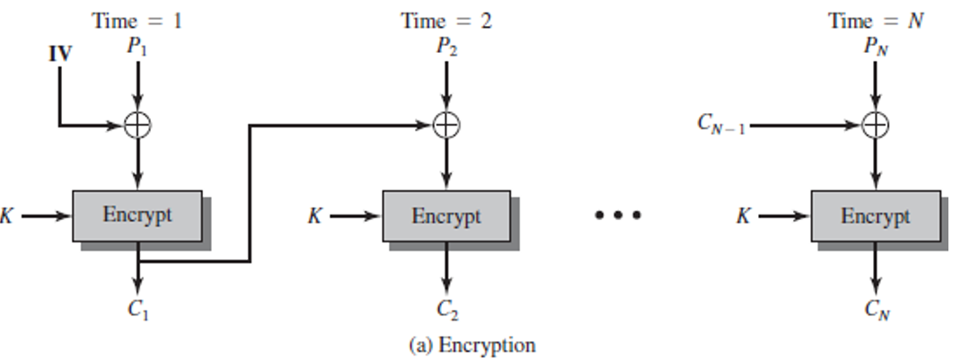
Quiz Block Cipher ANS con’t
Plain | 000 | 001 | 010 | 011 | 100 | 101 | 110 | 111
Cipher | 111 | 110 | 101 | 100 | 011 | 010 | 000 | 001
Plaintext 100101100
The first step is to XOR the first plaintext block with IV = 111
First plaintext block: 100, so 100⊕111=011
Now we encrypt this result (011) using our cipher table: 011 maps to 100.
Second Block: Now we XOR the second plaintext block with the first ciphertext block:
Second plaintext block: 101, so 101⊕100=001
Now we encrypt this result (001) using our cipher table: 001 maps to 110.
Third Block: Finally, we XOR the third plaintext block with the second ciphertext block:
Third plaintext block: 100, so 100⊕110=010
Now we encrypt this result (011) using our cipher table: 010 maps to 101.
Resulting ciphertext for plaintext 100101100 is 100110101.
111
100
101
110
100
011
001
010
100
110
101
The same plaintext 100 is encrypted into different cyphertexts (100 or 101) at different positions in the input, thanks to CBC.

